Slide 1
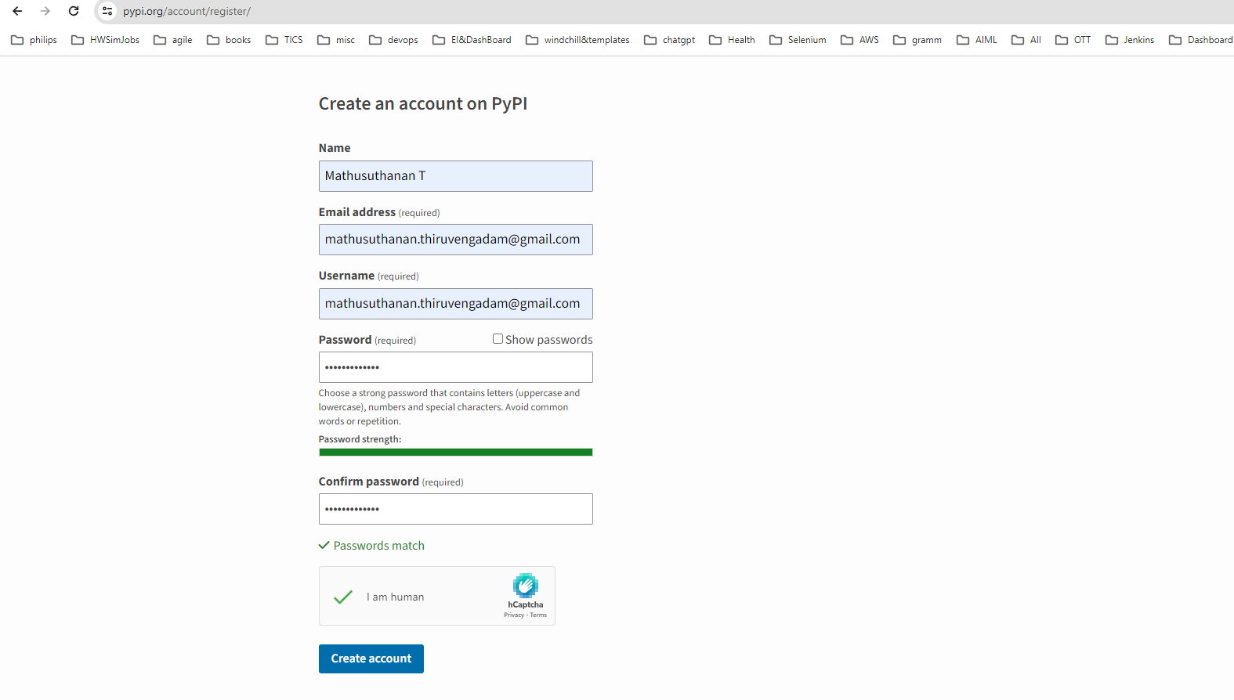
Setup PYPI account

Slide 2
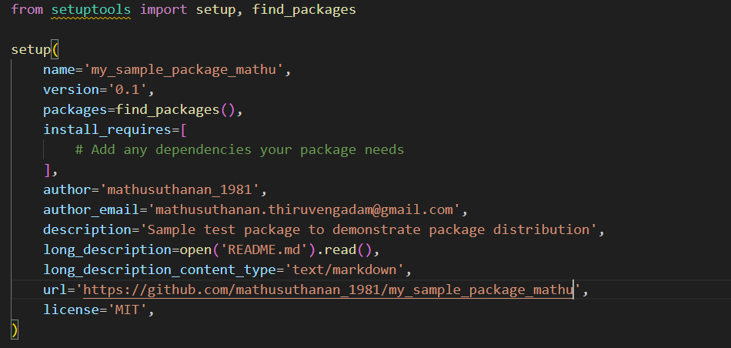
Prepare setup file

Slide 3
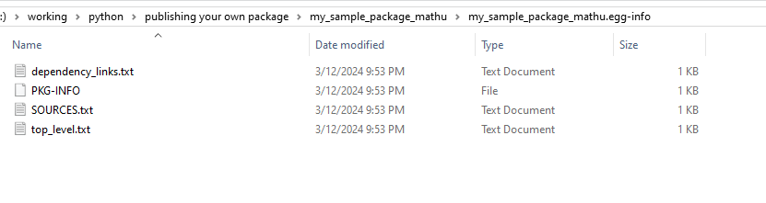
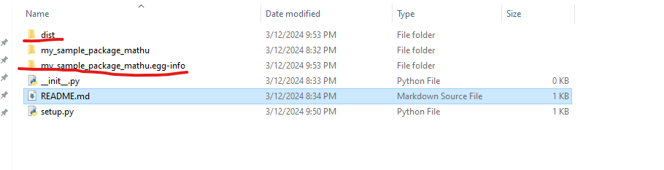
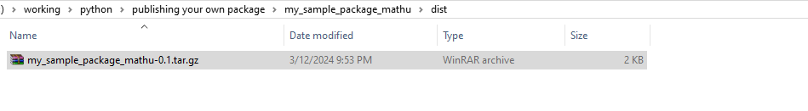
Execute the following commands
> pip install setuptools
> pip install twine
> python setup.py sdist
> twine upload dist/*
It creates two new folders

Slide 4
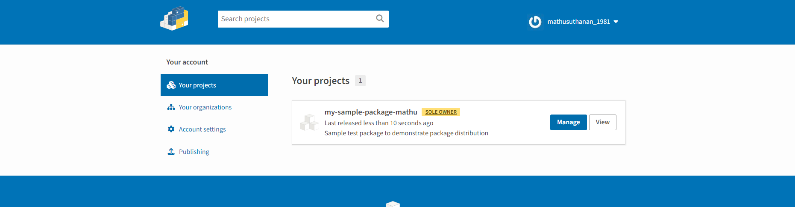

Slide 5
C:\working\python>pip install my-sample-package-mathu
Collecting my-sample-package-mathu
Downloading my_sample_package_mathu-0.1.tar.gz (1.1 kB)
Installing build dependencies ... done
Getting requirements to build wheel ... done
Installing backend dependencies ... done
Preparing metadata (pyproject.toml) ... done
Building wheels for collected packages: my-sample-package-mathu
Building wheel for my-sample-package-mathu (pyproject.toml) ... done
Created wheel for my-sample-package-mathu: filename=my_sample_package_mathu-0.1-py3-none-any.whl size=1253 sha256=60fd088bc48e5ec031b2c7c7d83dddd297fcfeae4dcc8ca5329b2a4cb6f52f5f
Stored in directory: c:\users\lenovo\appdata\local\pip\cache\wheels\62\a8\27\705d79a4de22e738875109c156a7afe952b45714d19e70fbe3
Successfully built my-sample-package-mathu
Installing collected packages: my-sample-package-mathu
Successfully installed my-sample-package-mathu-0.1

